Slide 1
Introduction Machine learning methods on Graphs

Slide 2
Outline
Machine learning with Graphs
Applications and use cases
Different types of tasks:
Node level
Edge level
Graph level

Slide 3
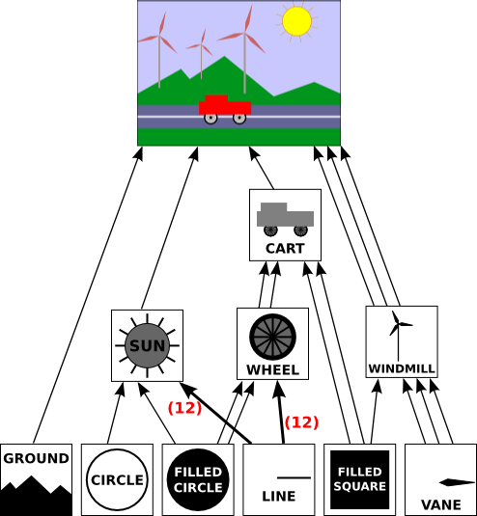
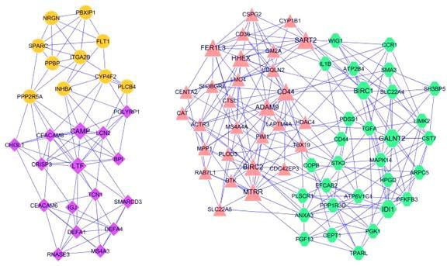
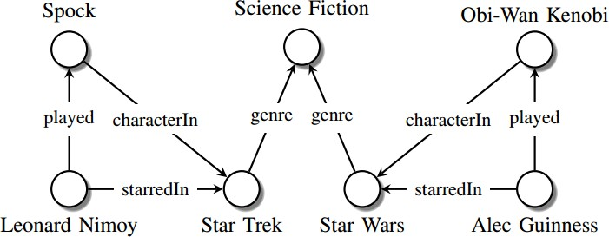
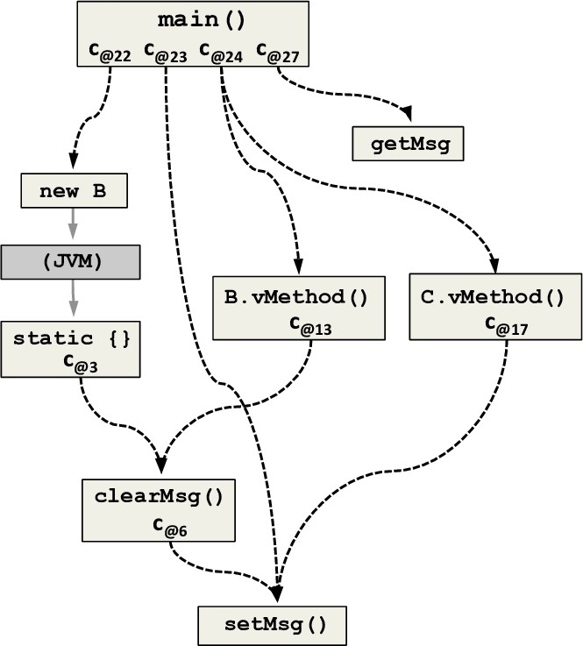
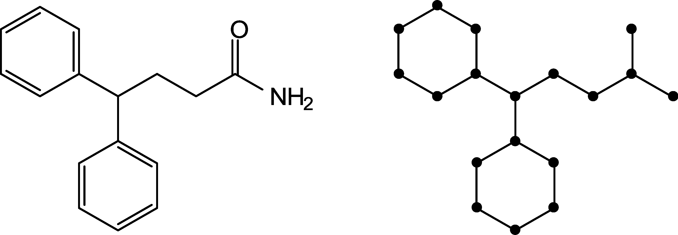
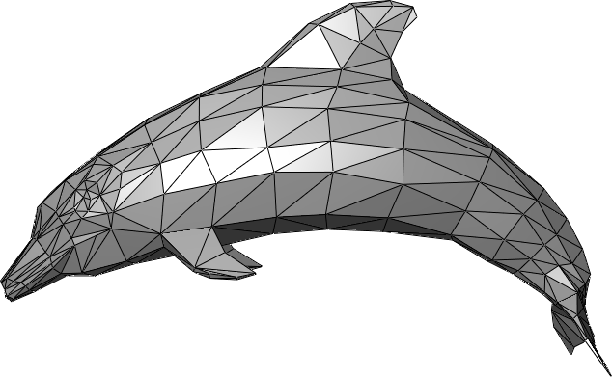
Main question:
Image cred
it: Maximilian Nickel et al Image credit: ese.wustl.edu Image credit: m
^{ledge Graphs} Regulatory Networks Scene
ath.hws.edu
Know
How do we take advantage of relational structure for better prediction?
Graphs
Image credit: ResearchGate
Code Graphs
Image credit: MDPI
Image credit: Wikipedia
Molecules
3D Shapes

Slide 4
Complex domains have a rich relational structure, which can be represented as a relational graph
By explicitly modeling relationships we achieve better performance!

Slide 5
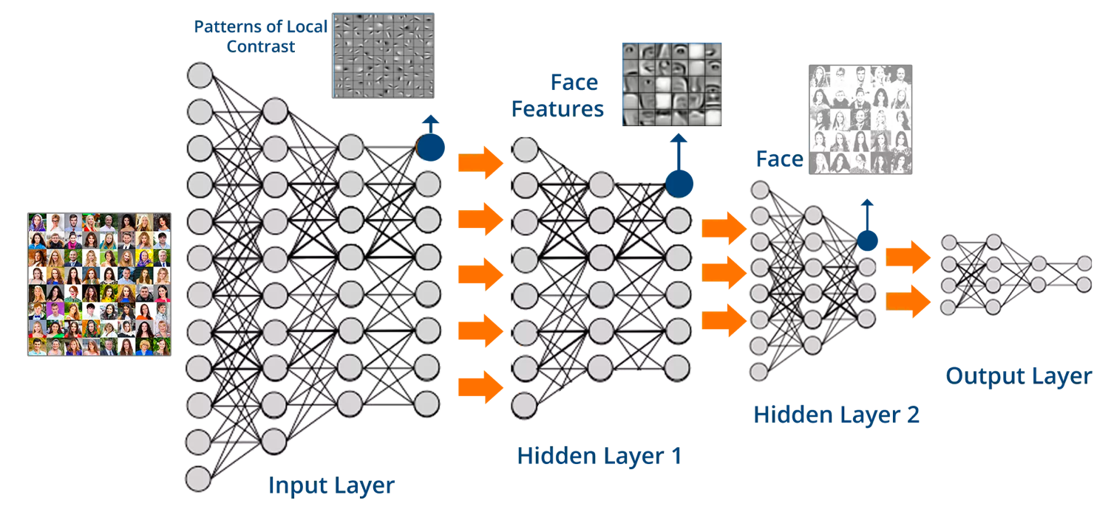
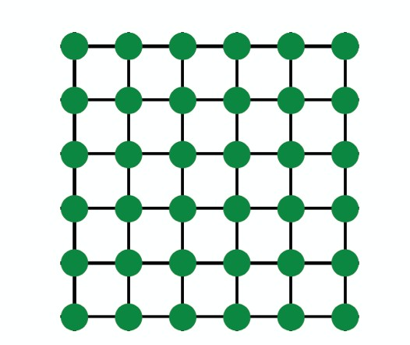
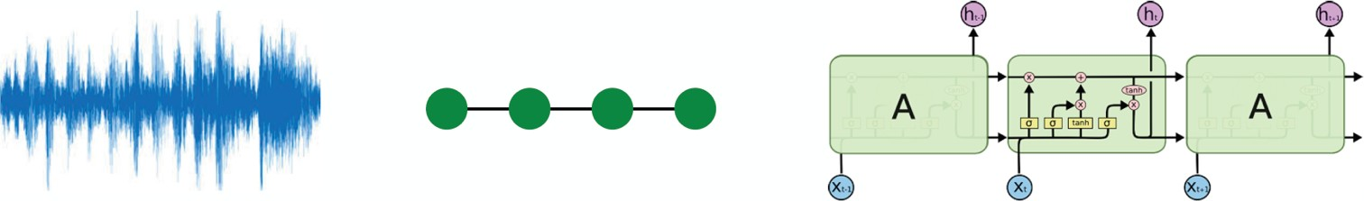
Images
Text/Speech
Modern deep learning toolbox is designed for simple sequences & grids

Slide 6

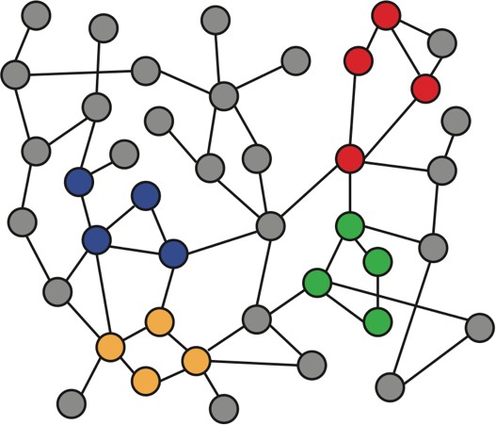
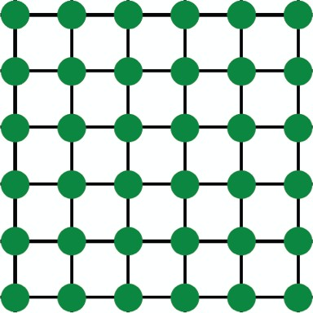

Networks are complex.
Arbitrary size and complex topological structure (i.e., no spatial locality like grids)
vs.
Text
Networks Images
No fixed node ordering or reference point
Often dynamic and have multimodal features

Slide 7
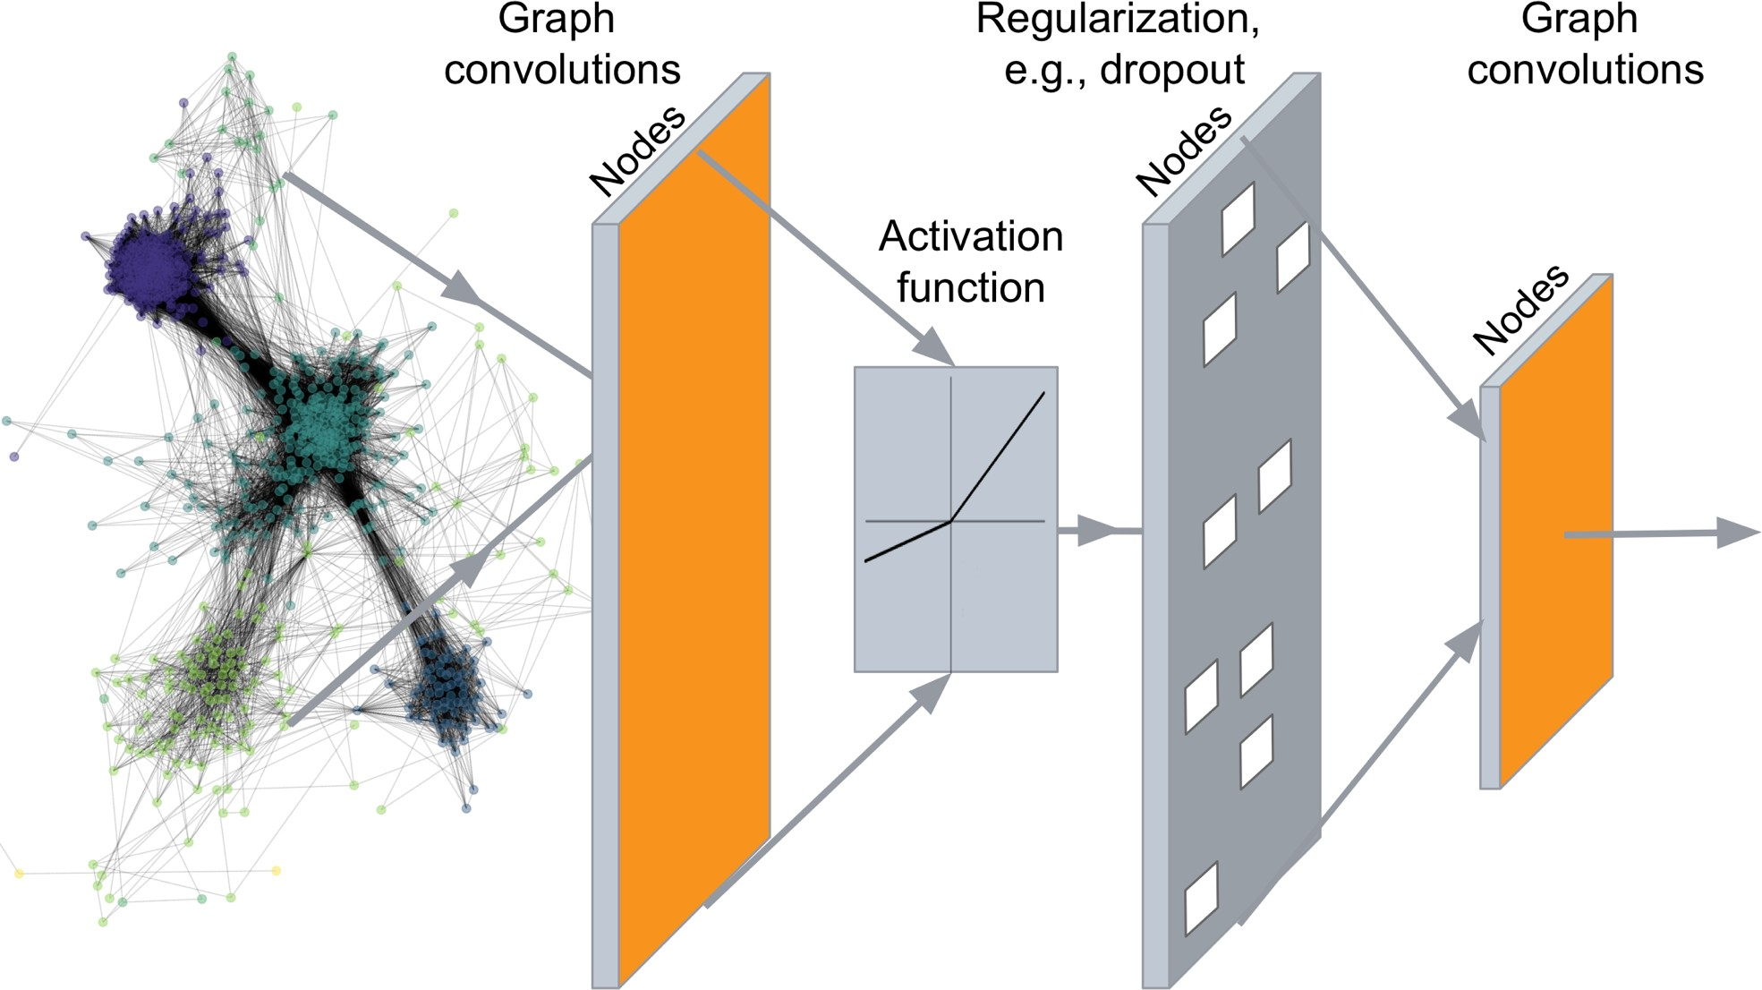
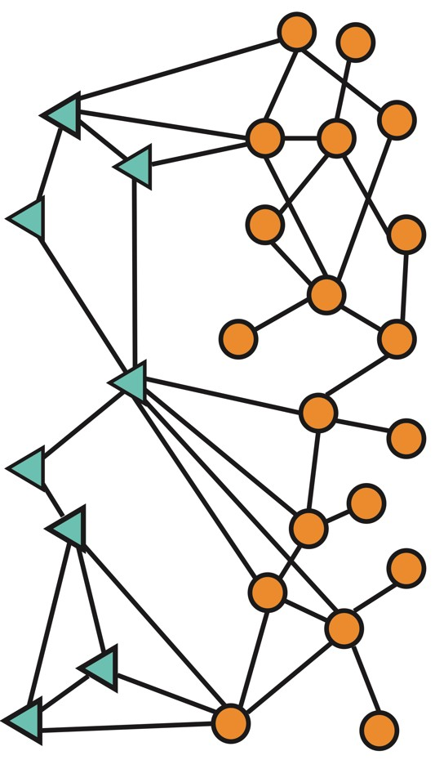
Deep Learning in Graphs
…
Predictions: Node labels, New links, Generated graphs and subgraphs
Input: Network

Slide 8
Graph Representation Learning
Raw Data
Graph Data
Learning Algorithm
Model
Feature Engineering
Representation Learning -- Automatically learn the features
Downstream prediction task

Slide 9
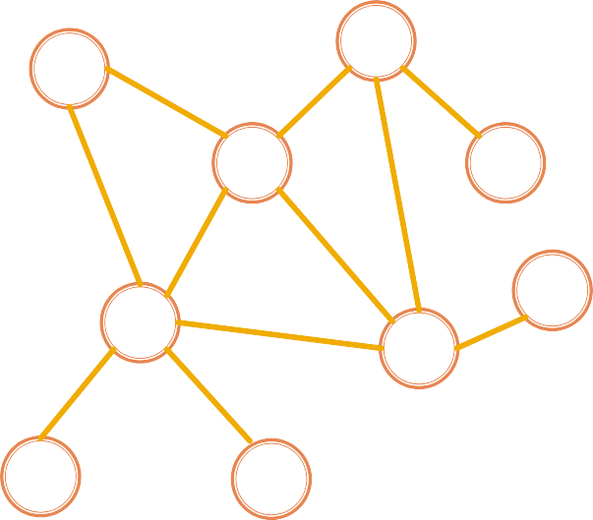
Map nodes to d-dimensional embeddings such that similar nodes in the network are embedded close together
Graph Representation Learning
node representation
u
Learn a neural network
𝒇: 𝑢 → ℝ^{d}
_{ℝ}d
Feature representation, embedding

Slide 10
Applications of Graph ML

Slide 11
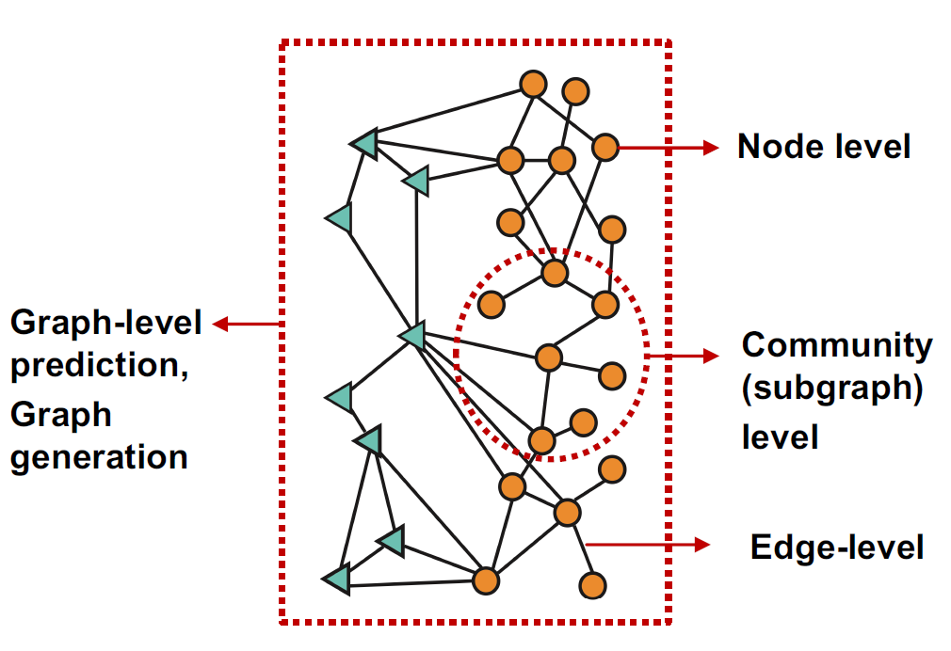
Different Types of Tasks

Slide 12
Node classification: Predict a property of a node
Example: Categorize online users / items
Link prediction: Predict whether there are missing links between two nodes
Example: Knowledge graph completion
Graph classification: Categorize different graphs
Example: Molecule property prediction
Clustering: Detect if nodes form a community
Example: Social circle detection
Other tasks:
Graph generation: Drug discovery
Graph evolution: Physical simulation

Slide 13
Node classification: Predict a property of a node
Example: Categorize online users / items
Link prediction: Predict whether there are missing
links
between two nodes
mple: Knowledge graph completion
h classification: Categorize different gra
mple: Molecule property prediction
ering: Detect if nodes form a community
mple: Social circle detection
These Graph ML tasks lead to high-impact applications!
Exa
Grap
phs
Exa
Clust
Exa
○ Other tasks:
▪ Graph generation: Drug discovery
▪ Graph evolution: Physical simulation

Slide 14
Node-level ML Tasks

Slide 15
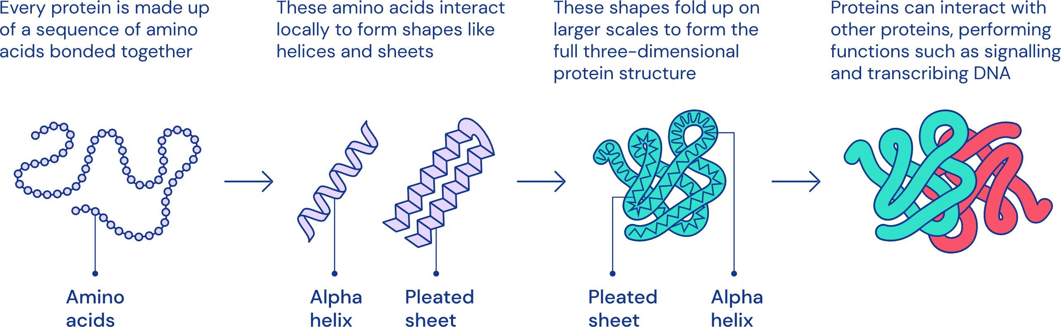
A protein chain acquires its native 3D structure
Image credit: DeepMind

Slide 16
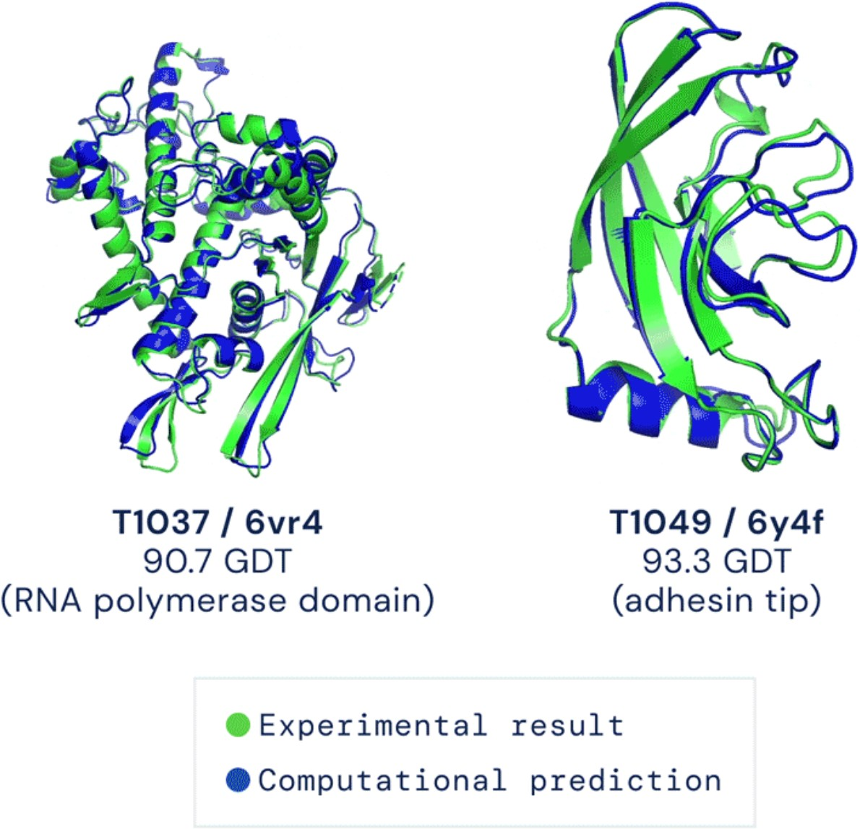
Computationally predict a protein’s 3D structure based solely on its amino acid sequence
Image credit: DeepMind

Slide 17

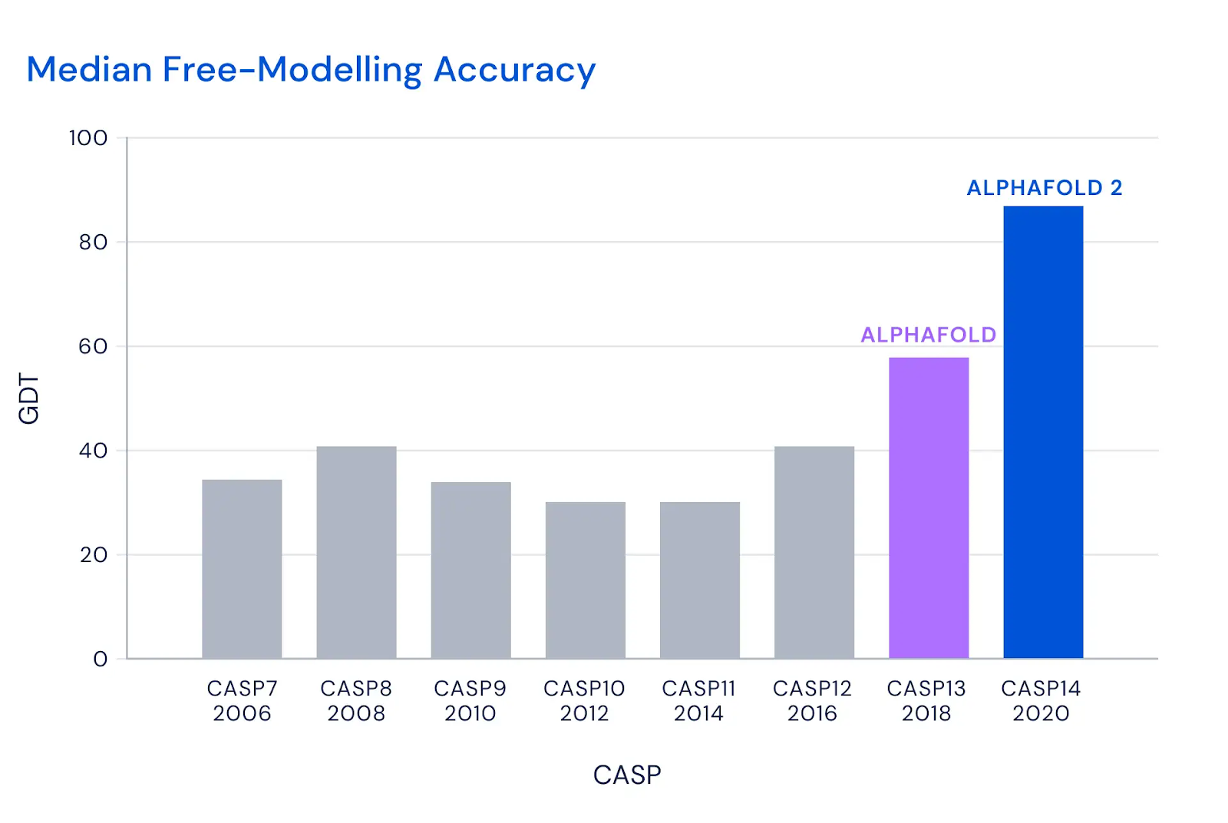
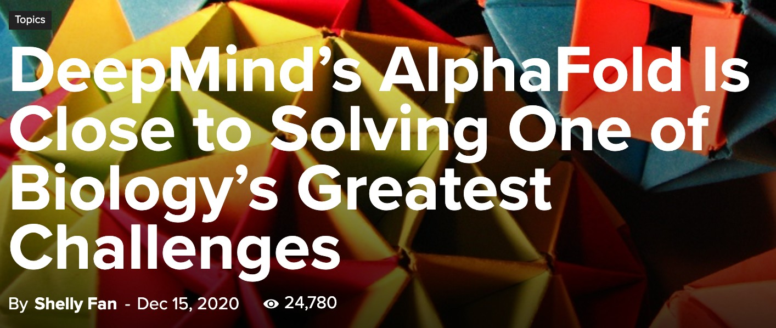

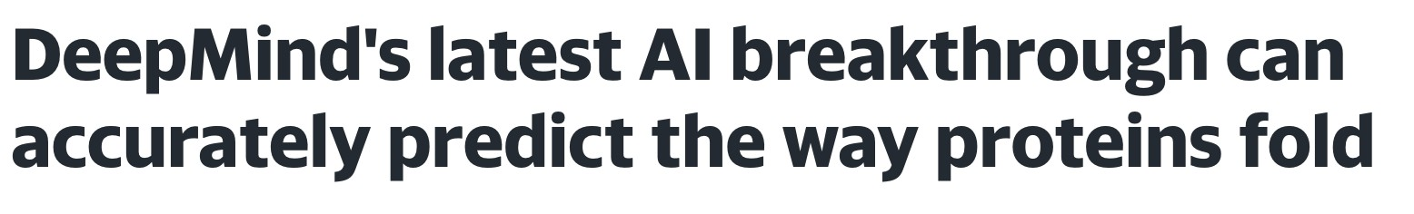
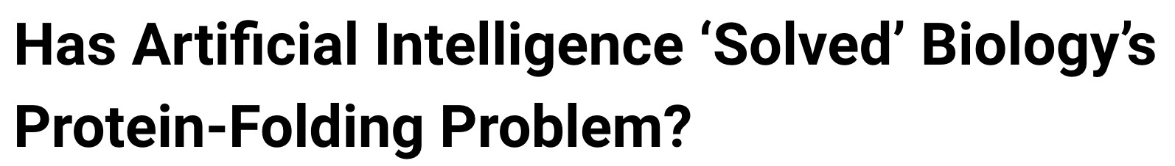
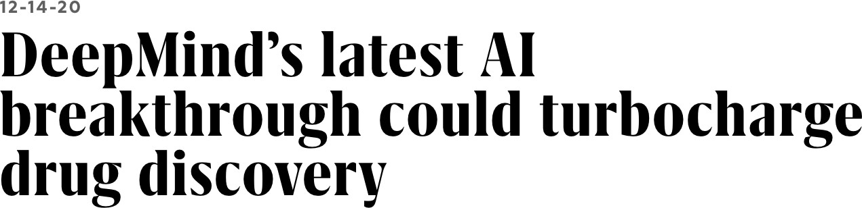
Image credit: DeepMind
Image credit: SingularityHub

Slide 18
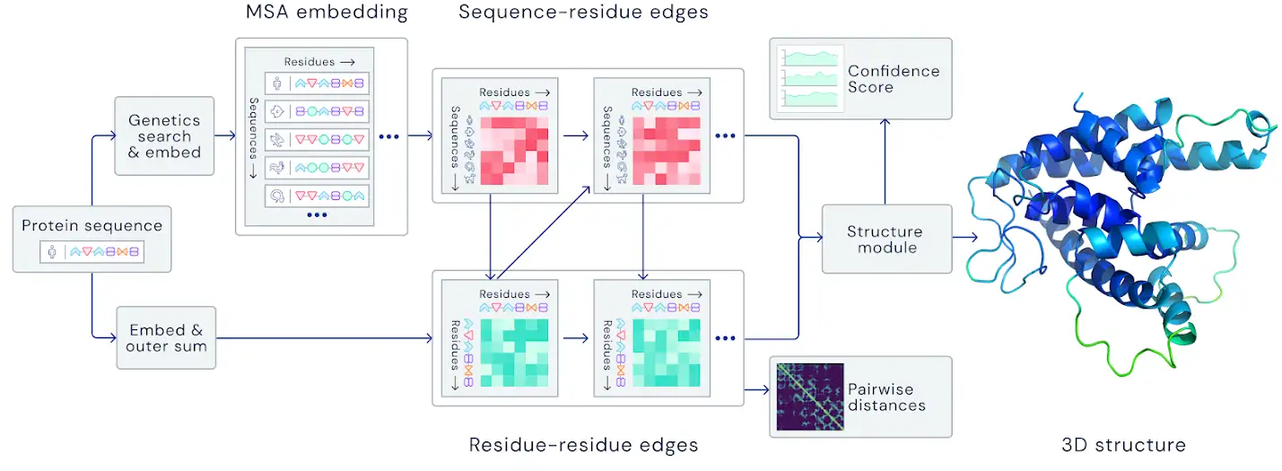
Key idea: “Spatial graph”
Nodes: Amino acids in a protein sequence
Edges: Proximity between amino acids (residues)
Image credit: DeepMind
Spatial graph

Slide 19
Edge-level ML Tasks

Slide 20





Users interacts with items
Watch movies, buy merchandise, listen to music
Nodes: Users and items
Edges: User-item interactions
Goal: Recommend items users might like
Users
Interactions
“You might also like”
Items

Slide 21
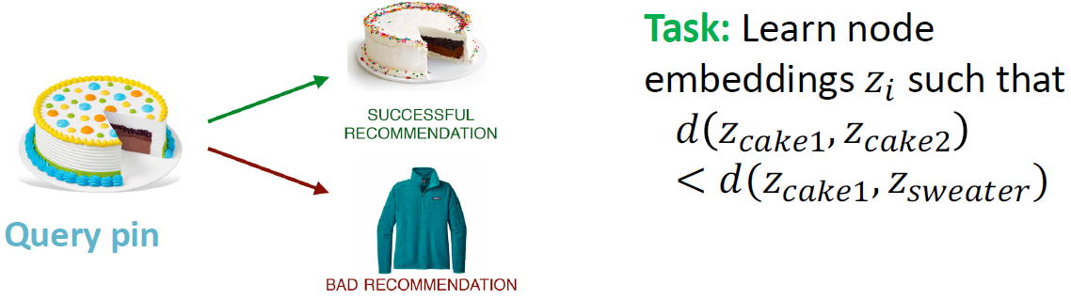




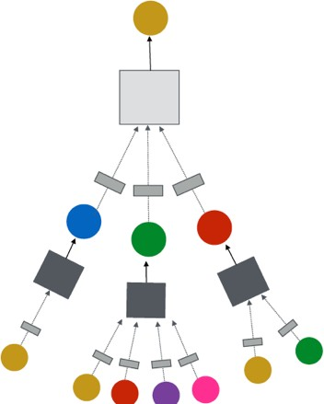
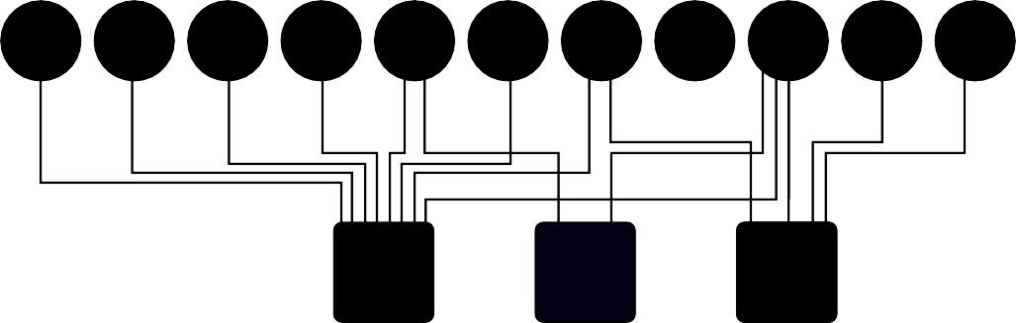

Task: Recommend related pins to users
Ying et al., Graph Convolutional Neural Networks for Web-Scale Recommender Systems, KDD 2018

Slide 22



Many patients take multiple drugs to treat complex or co-existing diseases:
46% of people ages 70-79 take more than 5 drugs
Many patients take more than 20 drugs to treat heart disease, depression, insomnia, etc.
Task: Given a pair of drugs predict
adverse side effects
,
30%
prob.
65%
prob.

Slide 23
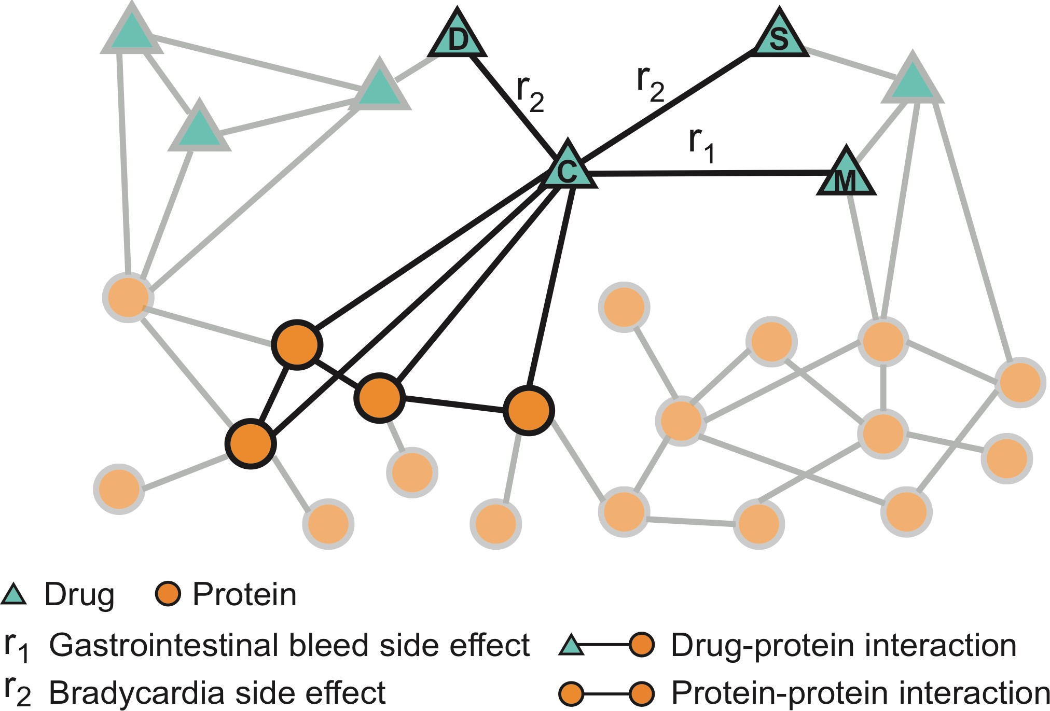
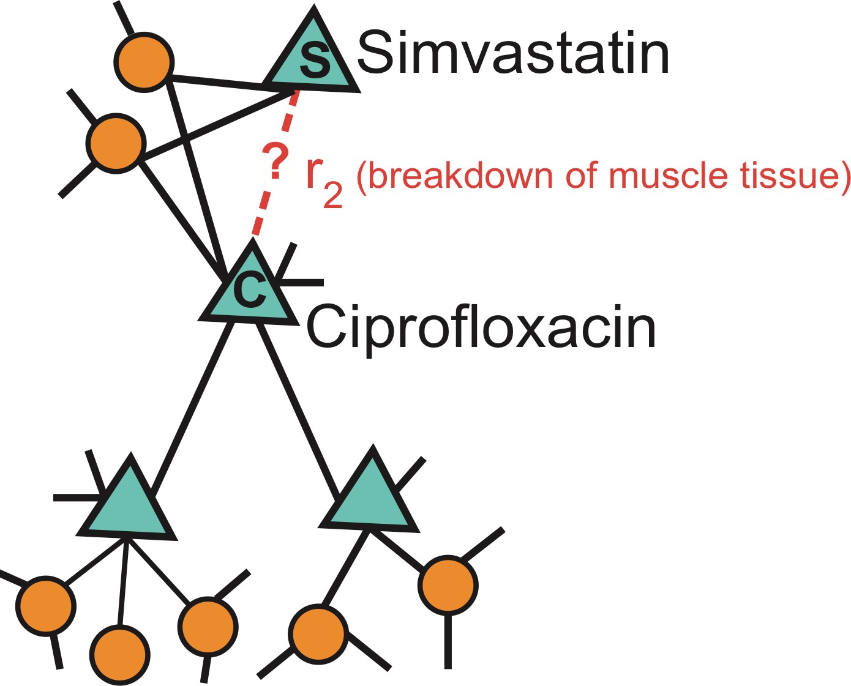
Zitnik et al., Modeling Polypharmacy Side Effects with Graph Convolutional Networks, Bioinformatics 2018
Nodes: Drugs & Proteins
Edges: Interactions
Query: How likely will Simvastatin and Ciprofloxacin, when taken together, break down muscle tissue?

Slide 24
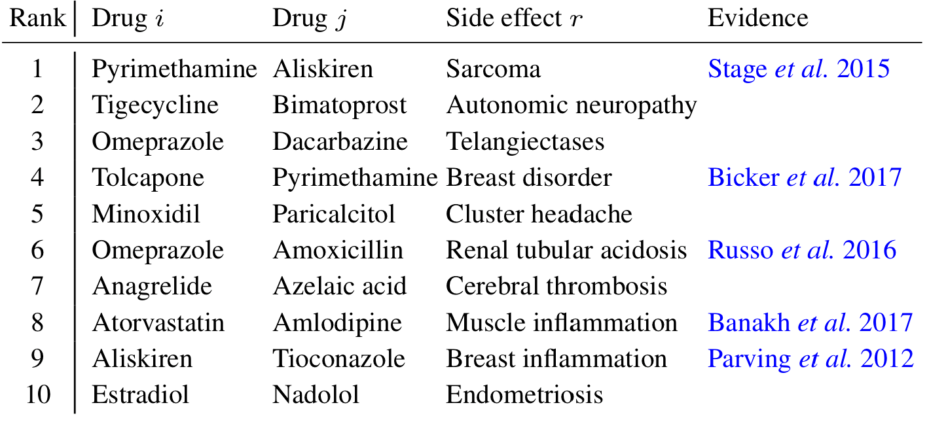
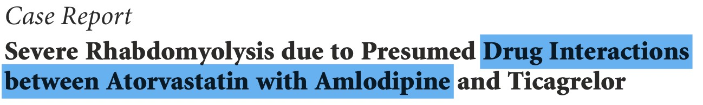
Drug c
Zitnik et al., Modeling Polypharmacy Side Effects with Graph Convolutional Networks, Bioinformatics 2018
Drug d
Evidence found

Slide 25
Subgraph-level Edge-level ML Tasks

Slide 26
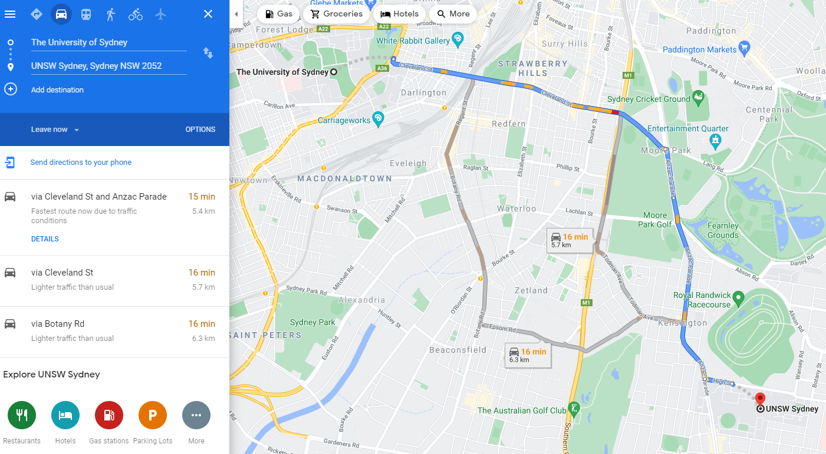
a

Slide 27
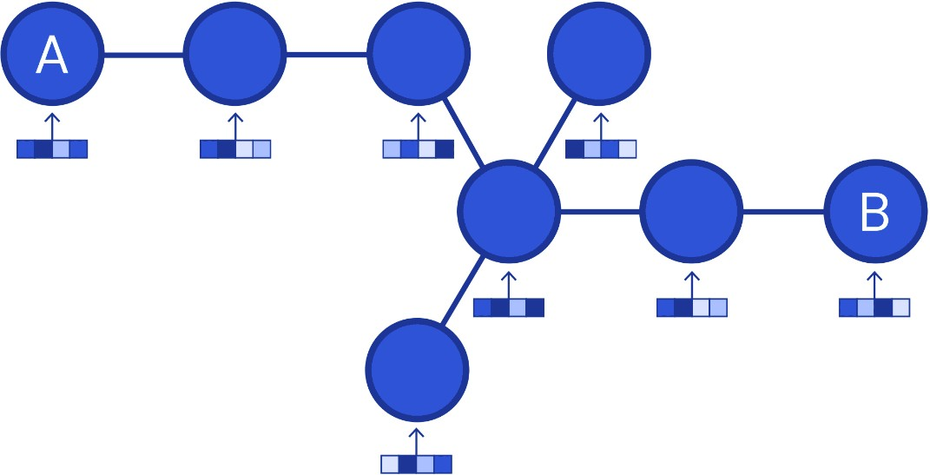
Nodes: Road segments
Edges: Connectivity between road segments
Image credit: DeepMind

Slide 28
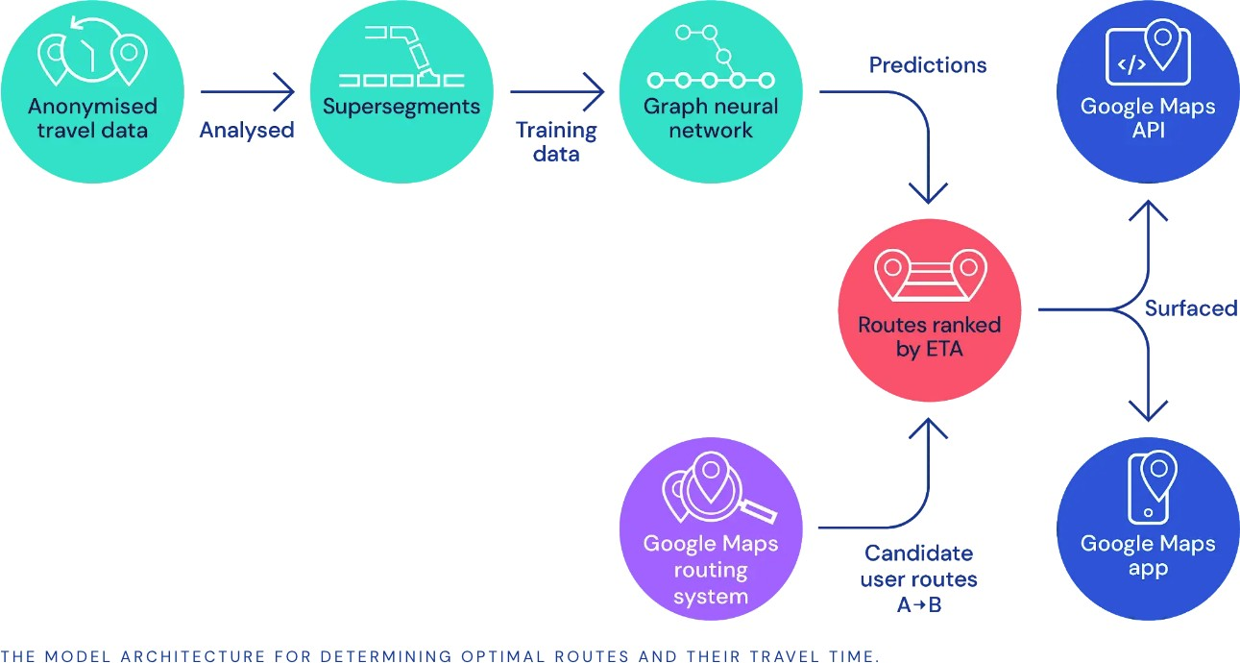

Predict via Graph Neural Networks
Used in Google Maps
Image credit: DeepMind

Slide 29
Graph-level ML Tasks

Slide 30
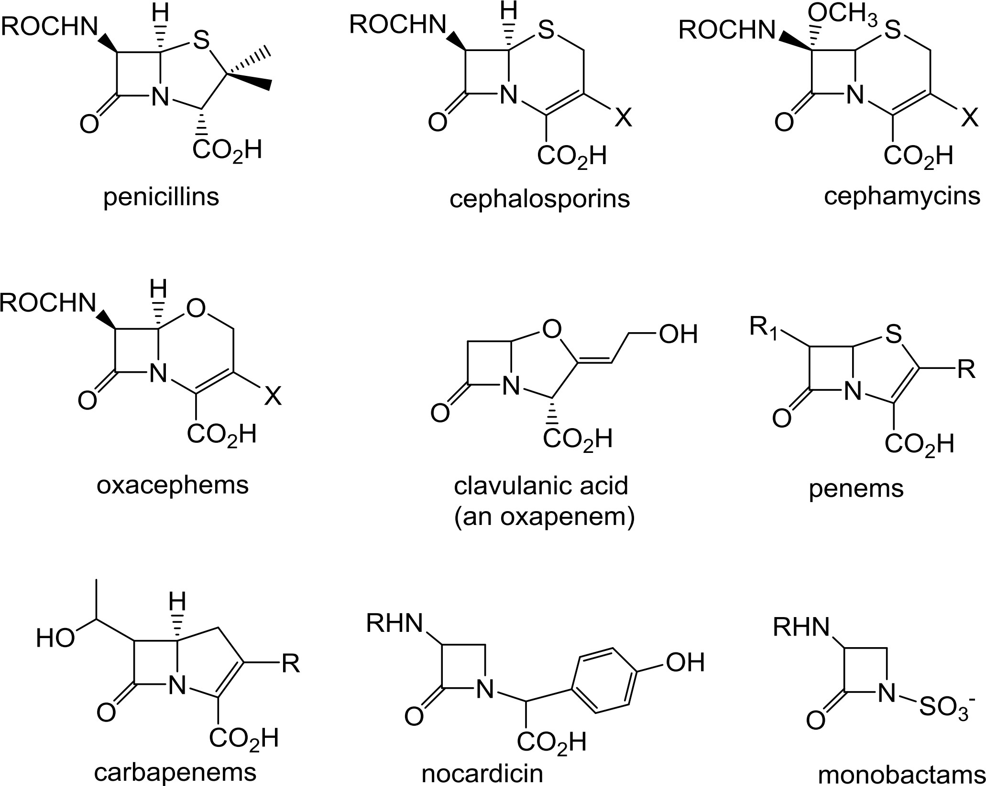
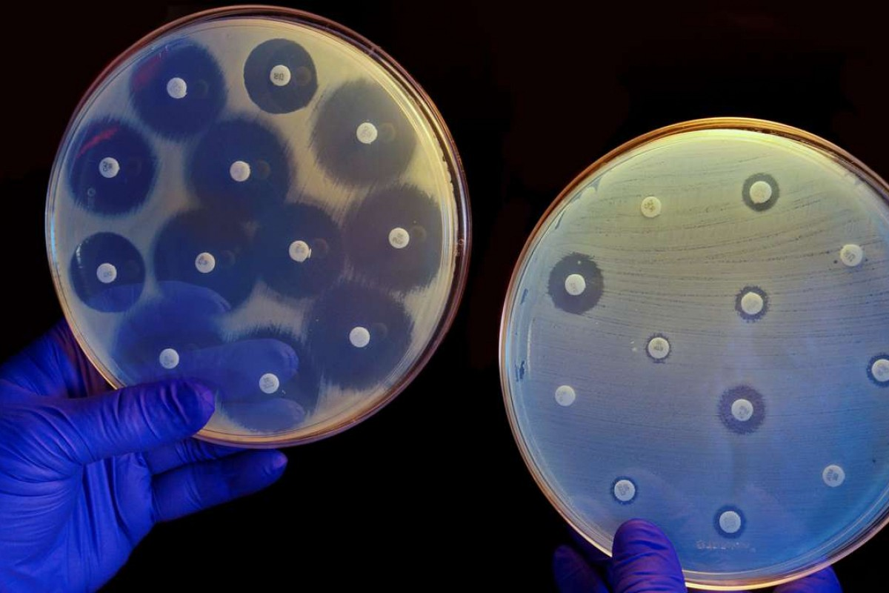
Antibiotics are small molecular graphs
Nodes: Atoms
Edges: Chemical bonds
Konaklieva, Monika I. "Molecular targets of β-lactam-based antimicrobials: beyond the usual suspects." Antibiotics 3.2 (2014): 128-142.
Image credit: CNN

Slide 31
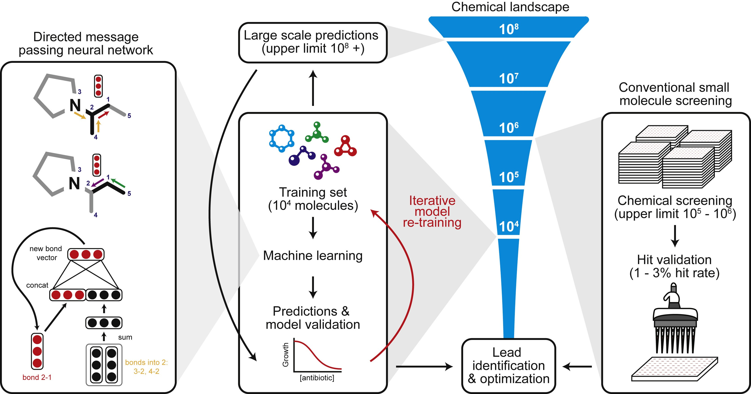
Stokes et al., A Deep Learning Approach to Antibiotic Discovery, Cell 2020
A Graph Neural Network graph classification model
Predict promising molecules from a pool of candidates
Stokes, Jonathan M., et al. "A deep learning approach to antibiotic discovery." Cell 180.4 (2020): 688-702.

Slide 32
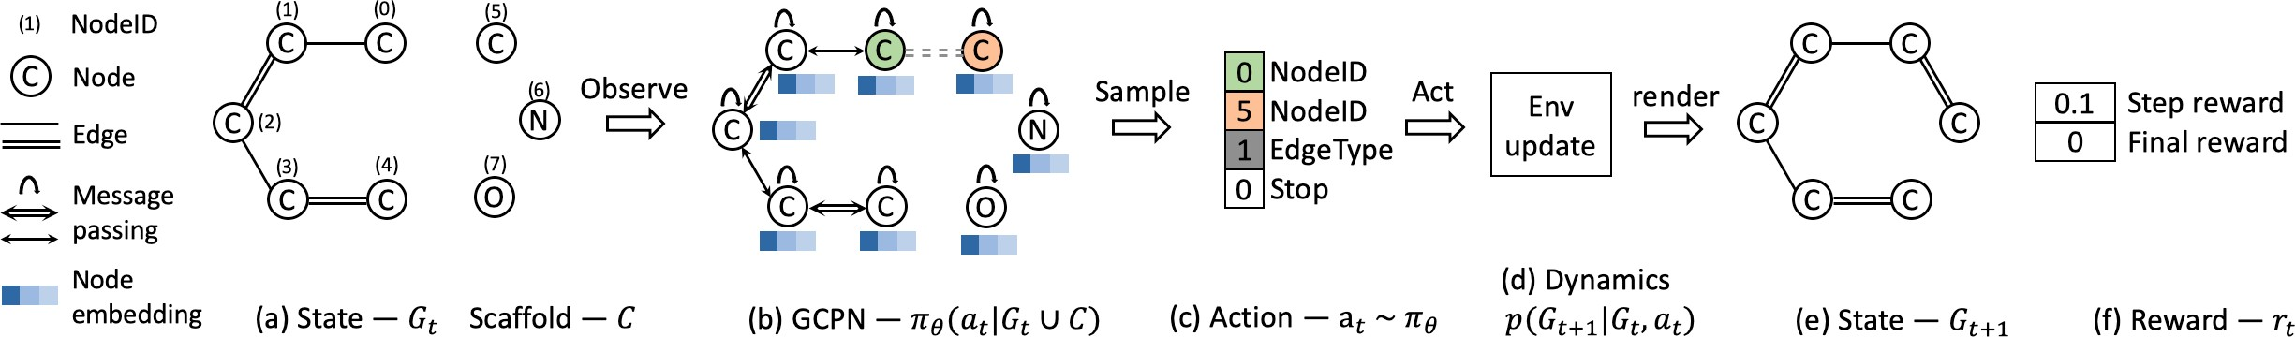
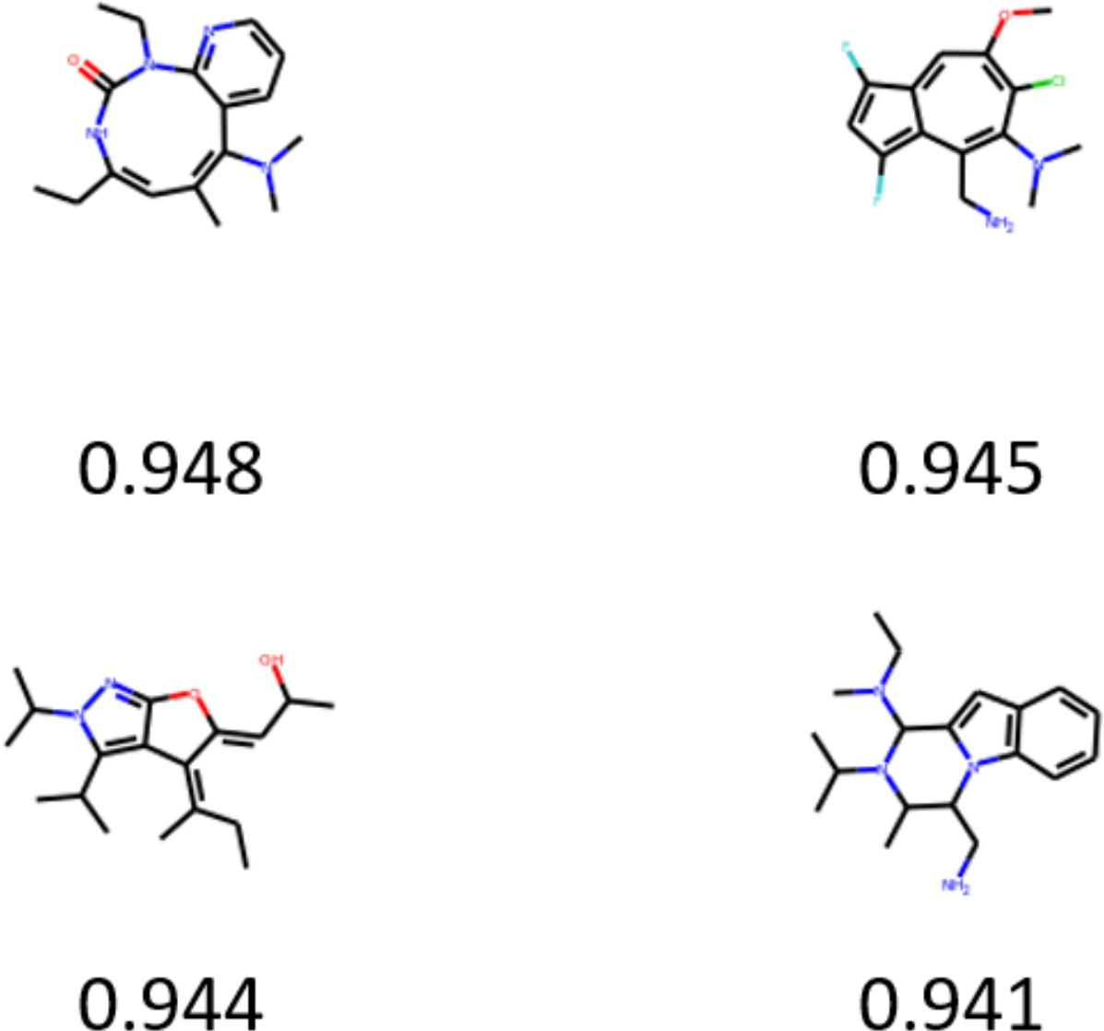
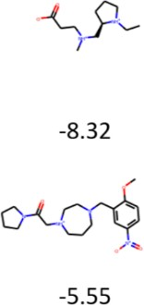
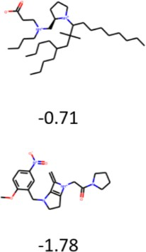
Graph generation: Generating novel molecules
You et al., Graph Convolutional Policy Network for Goal-Directed Molecular Graph Generation, NeurIPS 2018
Use case 1: Generate novel molecules with high drug likeness
Use case 2: Optimize existing molecules to have desirable properties

Slide 33
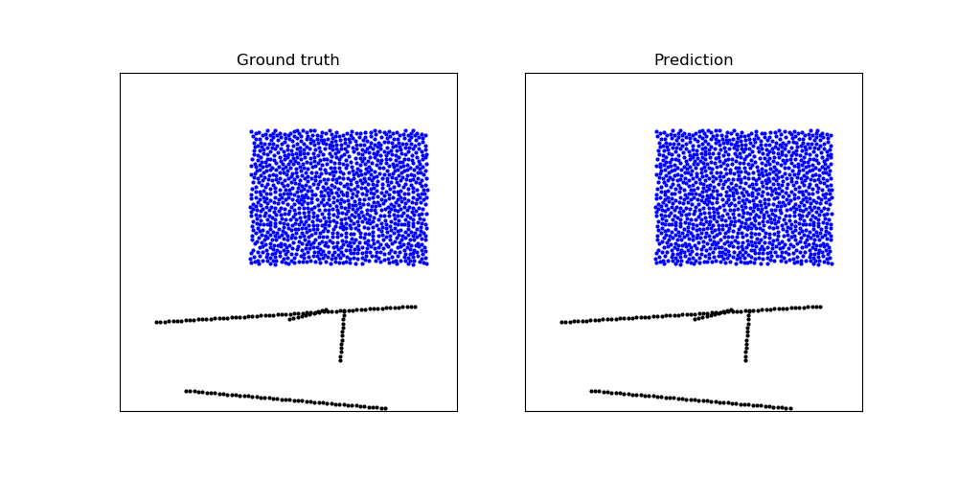
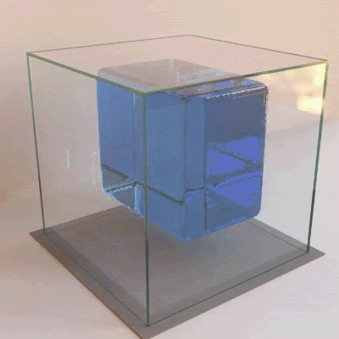
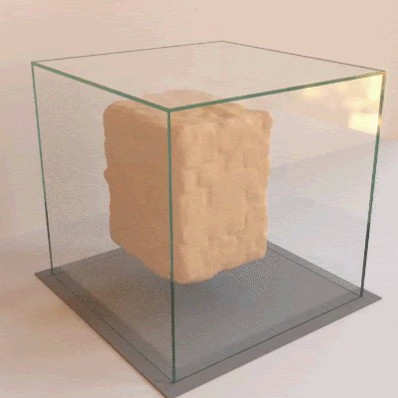
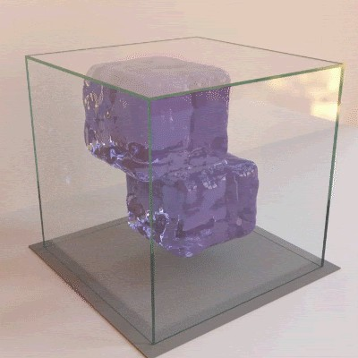
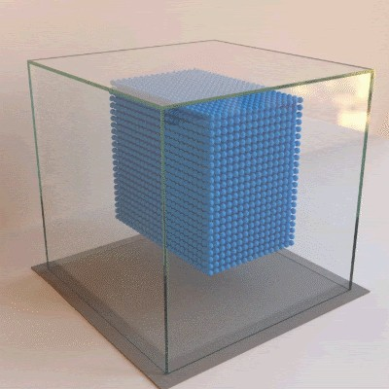
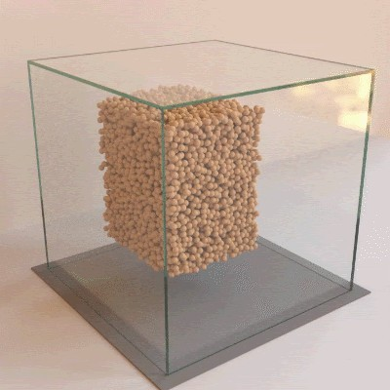
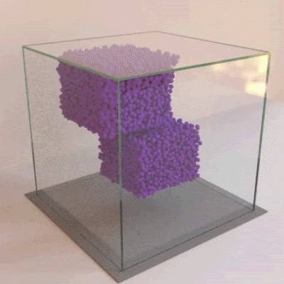
Physical simulation as a graph:
Sanchez-Gonzalez et al., Learning to simulate complex physics with graph networks, ICML 2020
Nodes: Particles
Edges: Interaction between particles

Slide 34
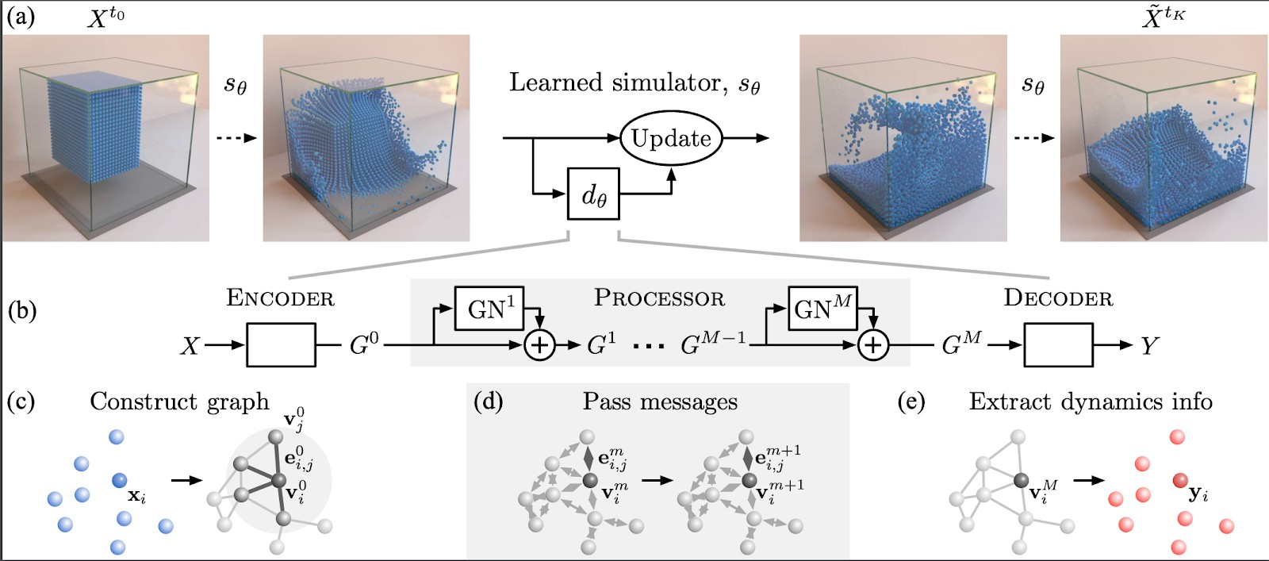
A graph evolution task:
Sanchez-Gonzalez et al., Learning to simulate complex physics with graph networks, ICML 2020
Goal: Predict how a graph will evolve over
me

Slide 35
Learning Outcomes
An Introduction of the machine learning methods on Graphs
Acknowledgement: Jure Leskovec, Stanford University
Notes:
General understanding of terms in databases, details will be found in later part of the course.

